Slide 1
Movie Recommendation System
Group 26:
Siddharth Devendra Gupta (sdg141)
Dhruvi Lalit Jain (dj470)

Slide 2
Problem Statement
Aim: Build a movie recommendation system based on ‘MovieLens’ dataset such that 80% of the user’s ratings are used for training and 20% for testing along with generating 10 recommendations of movies for each userId such that the user has not seen the movie before and evaluating the model based on the recommendations using metrics such as RMSE, MAE, Precision, Recall, F1-Score, NDCG.
Notes:
Implemented popularity model, content based model, collaborative filtering model and latent factor based model and combining the above to form a hybrid model.
Hyperparameter tuning, testing accuracy and evaluation of recommendations of each model

Slide 3
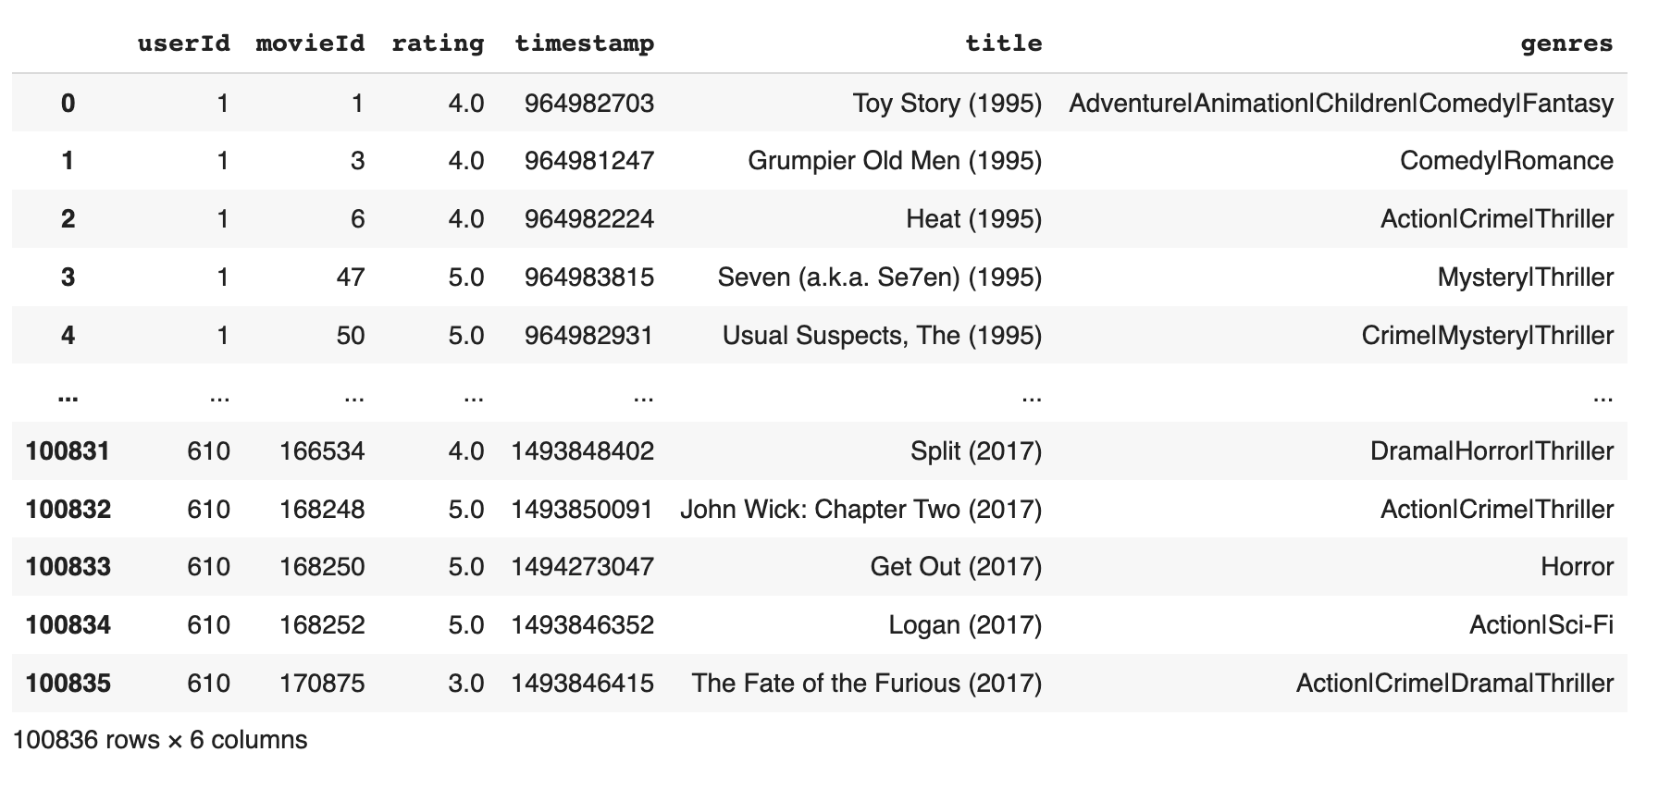
DataSet
MovieLens review dataset (ml-latest-small)
Ratings: 100k
Movies: 9k
Users: 600
Notes:
The primary dataset used for this project is the movielens review dataset. consisting of 27,753,444 reviews over 58,098 different movies by 283,228 users.

Slide 4
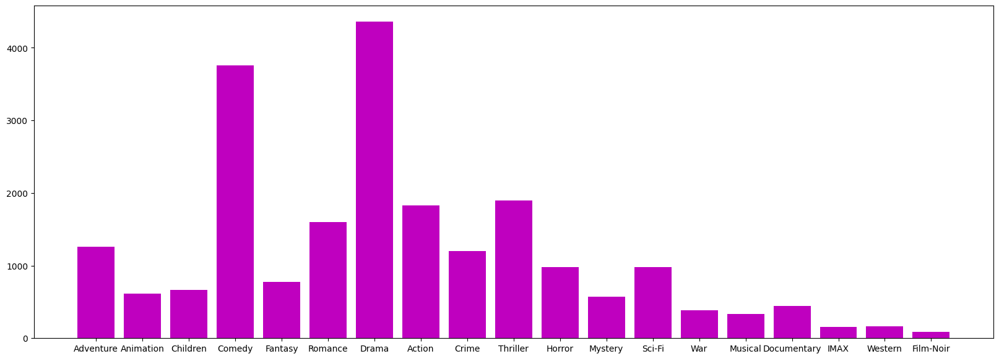
Data Analysis
Plot of genre versus movie

Slide 5
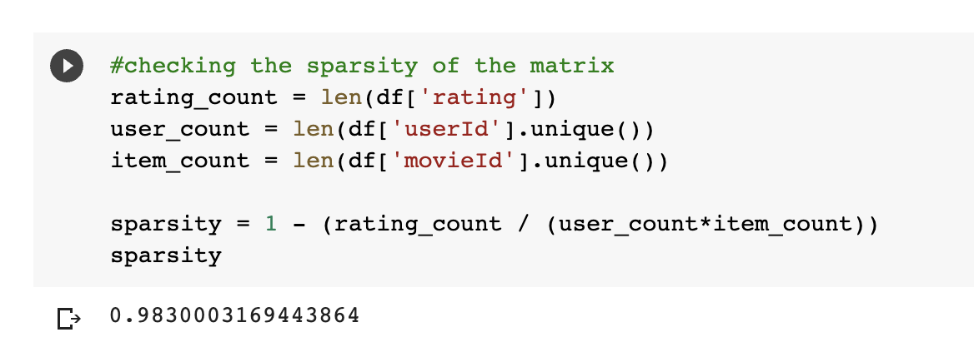
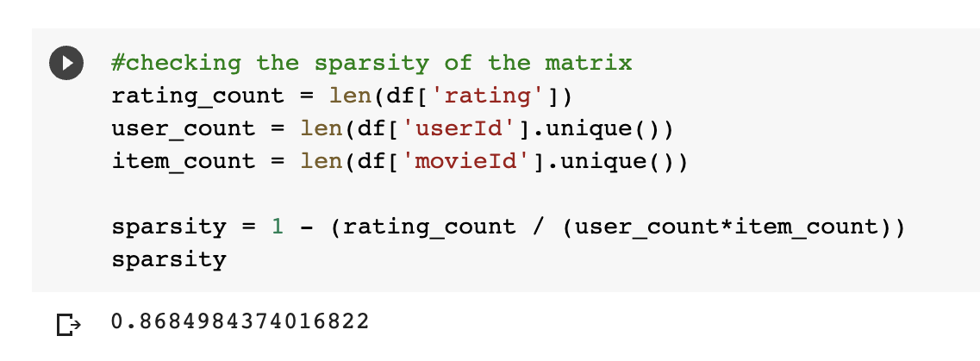
Sparsity Of Matrix Before And After Modifying Dataset

Slide 6
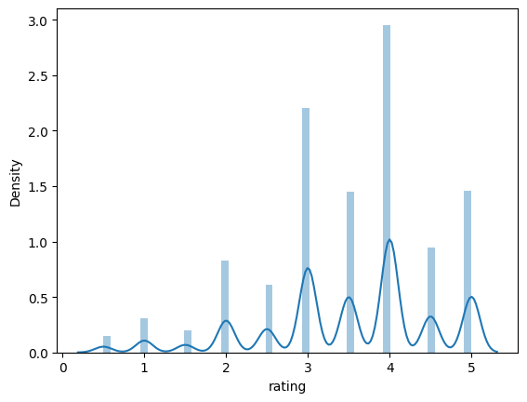
Plot of ratings versus Density of Ratings

Slide 7
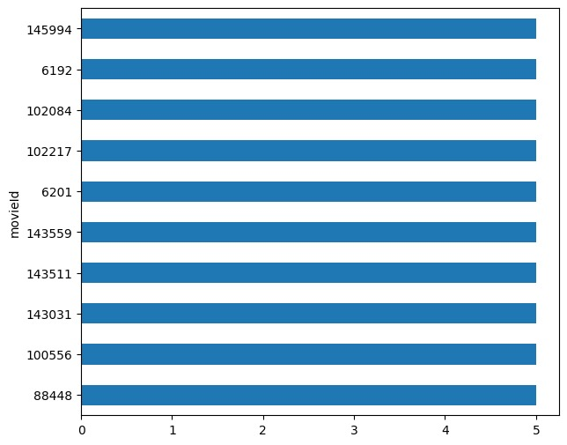
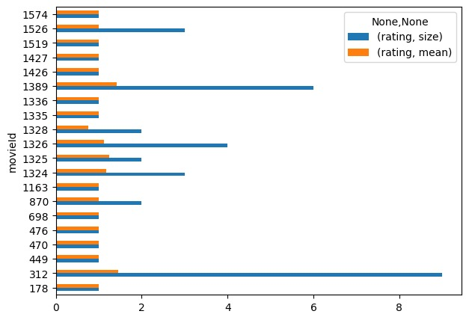
Movies with least ratings
Movies with most ratings

Slide 8
Types of Recommendation Systems Implemented
Content based model
User Item Model based on Genre
TF-IDF based on Genre
Collaborative Filtering
Memory Based Filtering
Item-Item Filtering
Model Based Filtering
Matrix Factorization using Pytorch
SVD
KNN

Slide 9
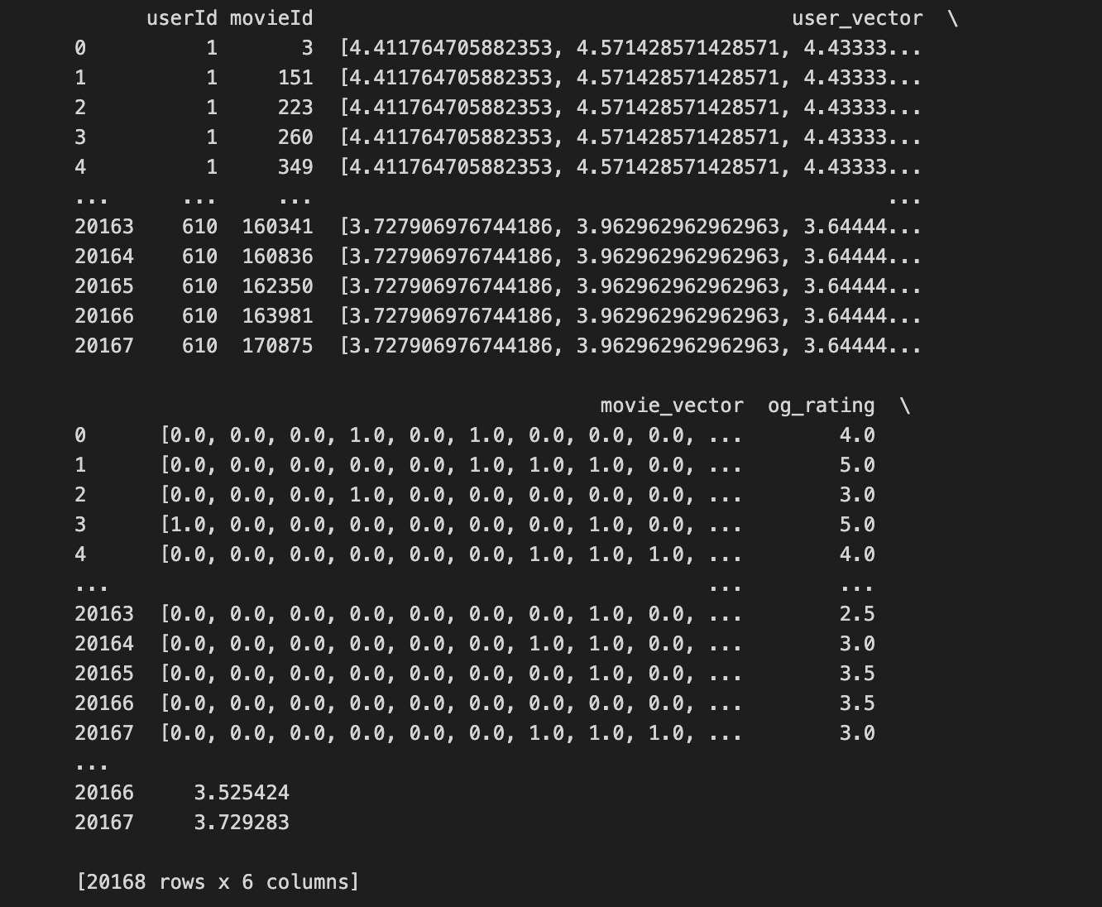
User and Item Vectors
Movie Vector:
A movie has multiple genres. A vector containing 1 for genres the movie belongs to and 0 for the rest of the genres (One Hot encoding for movies)
User Vector:
Vector of length total genres with the value of average rating for each genre based on ratings in train set
Notes:
Item profile = Based on the the genre list for each movie, we build a movie profile. Example movie 1 belongs to genre [“Action”],movie 2 is a RomCom movie, and so on.
Using the ratings data, which has ratings for a movie by the user, we build a user profile.
Each entry in the user profile vector depicts the affinity of the user for that specific genre.

Slide 10
Evaluation metrics
Metric | Content based
RMSE | 0.9185
MAE | 0.7095
Metric | Content based
Precision | 0.800932214
Recall | 0.495168862
F-Measure | 0.6119842046
NDCG | 0.945576877

Slide 11
Movie-Movie Similarity
TF-IDF using similarity of movies based on genres
Term frequency : measure of how often a word appears in a document. Calculated by dividing the number of times a word appears in a document by the total number of words in that document.
IDF: measure of how common or rare a word is in a corpus of documents. Calculated by dividing the total number of documents in the corpus by the number of documents that contain the word.
Notes:
As it is clearly seen from the movie title, movies with Christmas and Santa Claus are returned

Slide 12
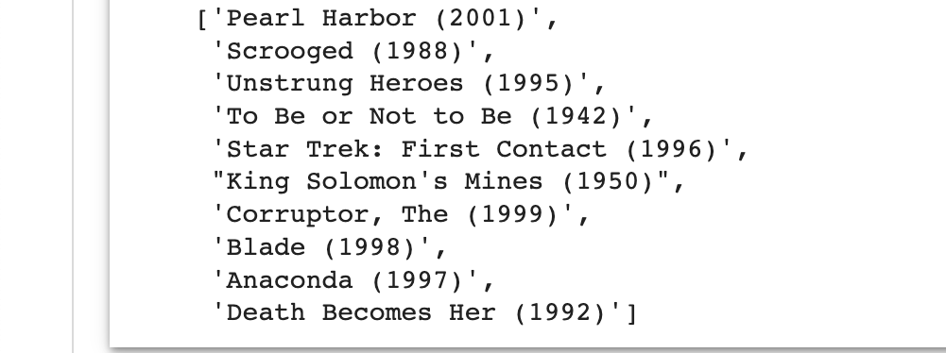
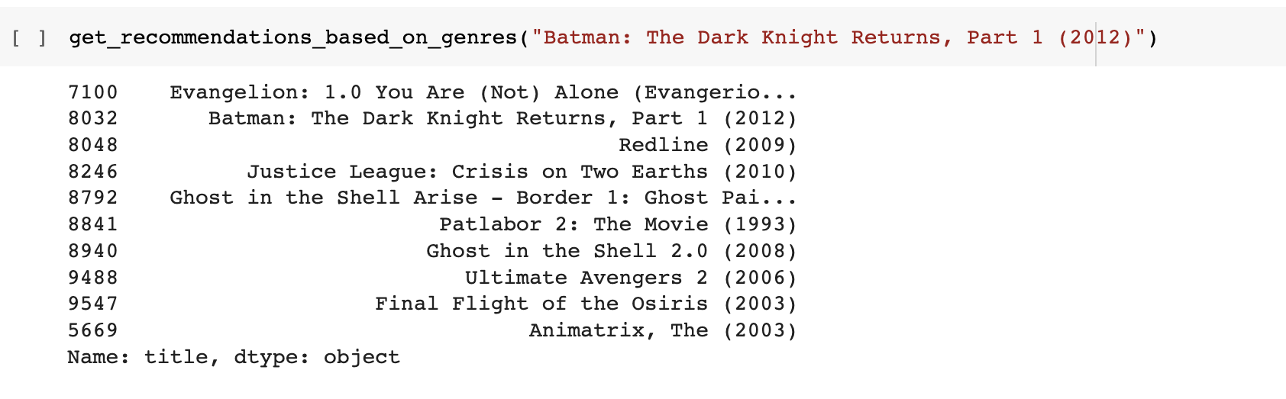
Movie-Movie Similarity
Notes:
As it is clearly seen from the movie title, movies with Christmas and Santa Claus are returned

Slide 13
Evaluation metrics
Metric | Content based
Precision | 0.94713675230
Recall | 0.99486489524
F-Measure | 0.96436773070
NDCG | 0.945576877

Slide 14
Collaborative Filtering
Memory Based Filtering
Item-Item Filtering
Model Based Filtering
Matrix Factorization
SVD
KNN
Notes:
Pearson Baseline: This method computes the Pearson correlation coefficient between all pairs of users (or items) using baselines for centering instead of means.

Slide 15
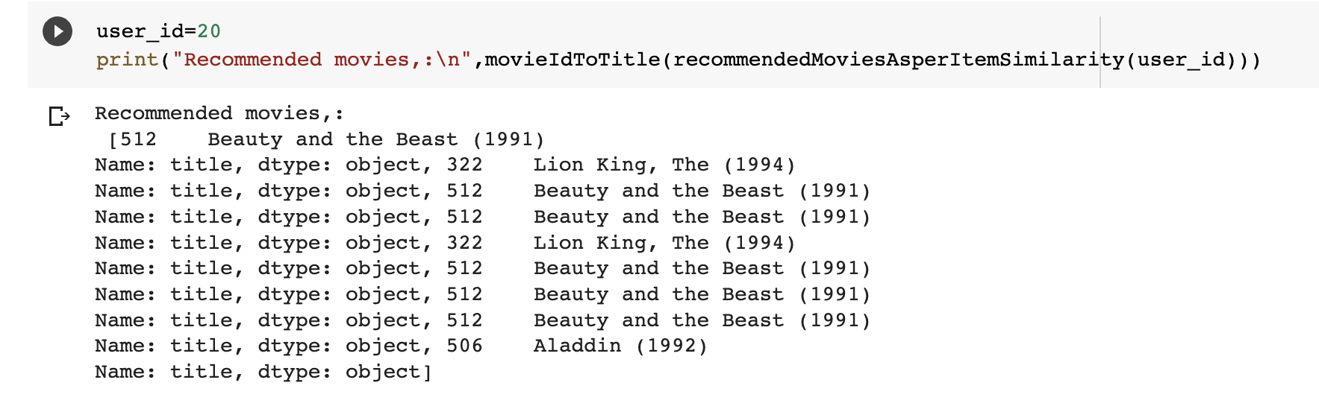
Item-Item Filtering
Recommending movies based on similar movies based on Cosine Similarity
Recommending movie which user hasn't watched as per Item Similarity

Slide 16
Matrix Factorization Using Pytorch
Goal: To learn the latent preferences of users and the latent attributes of items from known ratings to then predict the unknown ratings through the dot product of the latent features of users and items.
Works really well for sparse matrices.

Slide 17
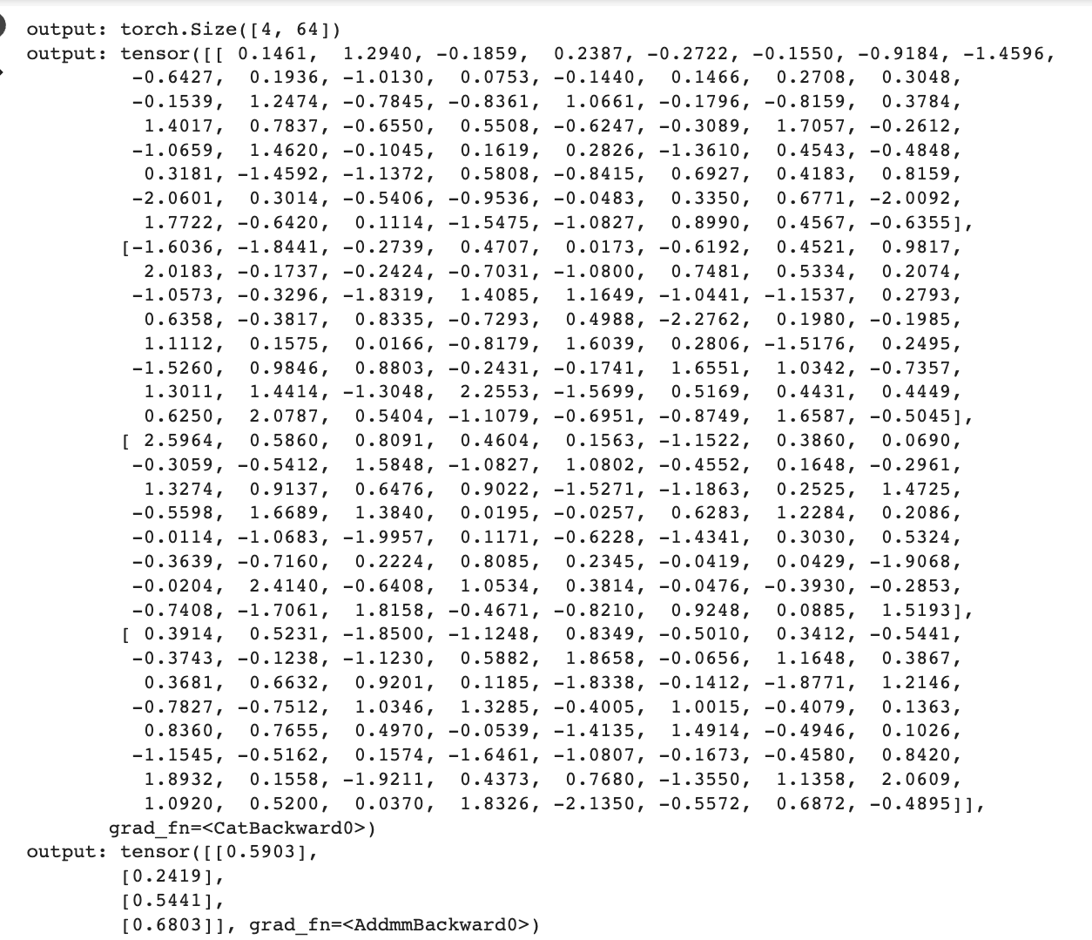
Concatenation of User and Movie Embeddings

Slide 18
Evaluation metrics
Metric | Matrix Factorization
RMSE | 0.35837694251
MAE | 0.45274051168
Metric | Matrix Factorization
Precision | 0.68926684881
Recall | 0.45665818044
F-Measure | 0.49204459195
NDCG | 0.56862526120

Slide 19
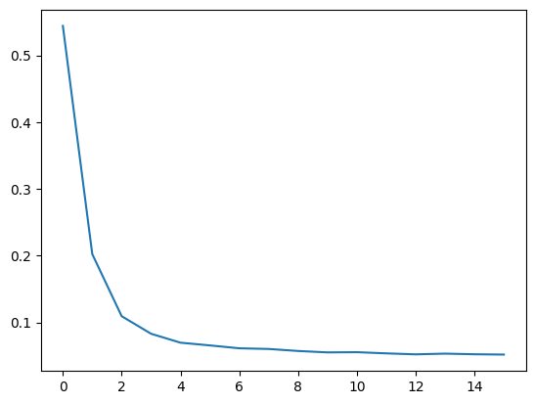
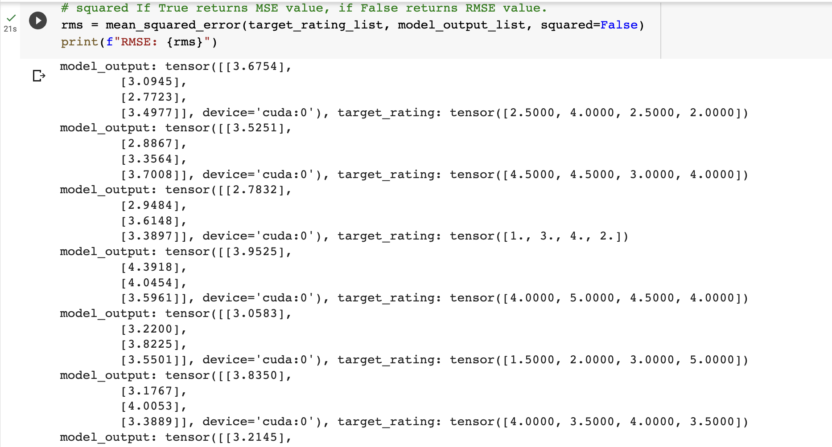
Plot of Loss for Matrix Factorization

Slide 20
Singular Value Decomposition
SVD decomposes a matrix into three matrices - U, Σ, and V - such that the original matrix can be reconstructed by multiplying the three matrices together.
U and V - orthogonal matrices and
Σ is a diagonal matrix

Slide 21
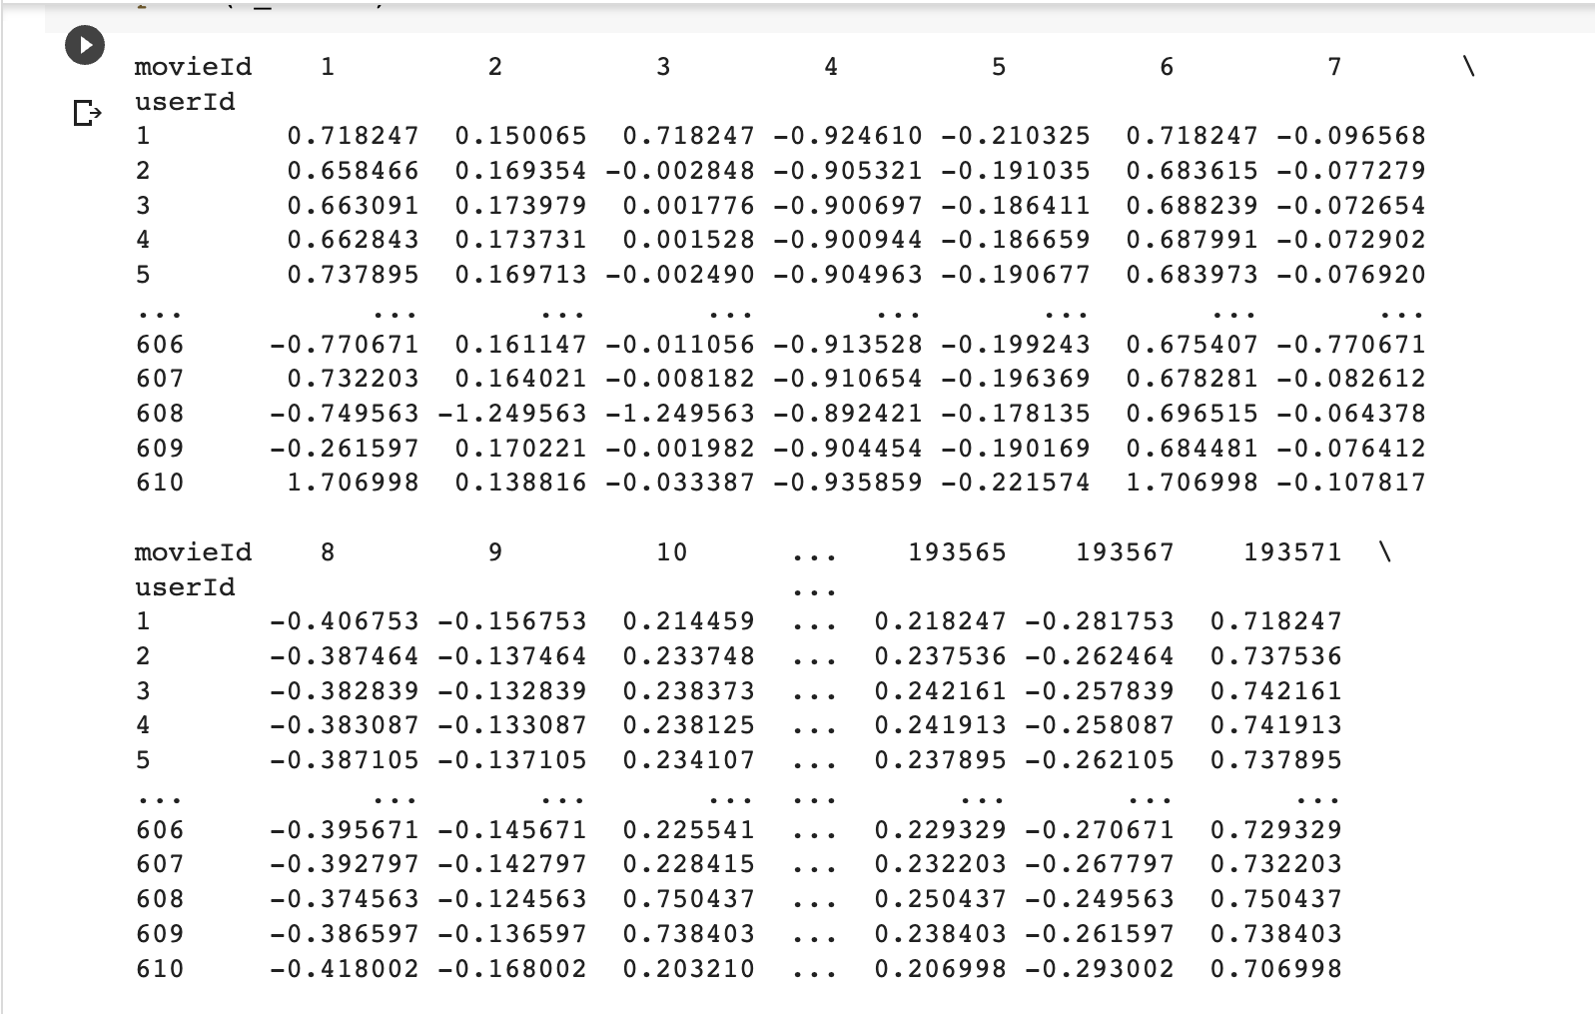
Pivot table with each rating subtracted from mean rating

Slide 22
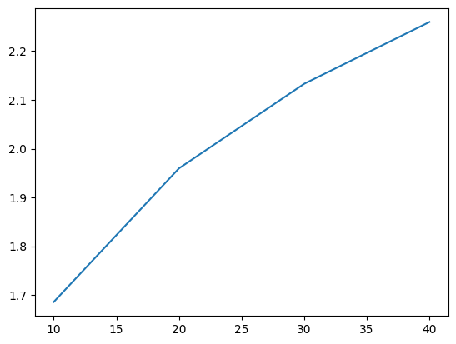
Plot of Loss for SVD and Evaluation Metrics
Metric | SVD
RMSE | 2.366175065
MAE | 1.9820137758

Slide 23
K-Nearest Neighbors
Approach: To find the K closest data points in the training set to a new data point and classify or predict the target variable based on the labels or values of those K nearest neighbors.

Slide 24
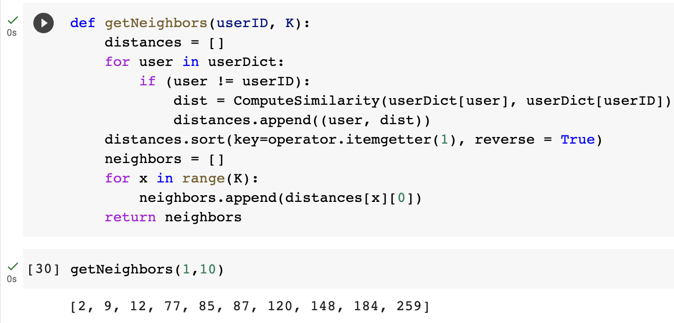
Nearest Neighbors and Evaluation Metrics
Metric | KNN
RMSE | 0.848747249426
MAE | 0.711738731264

Slide 25
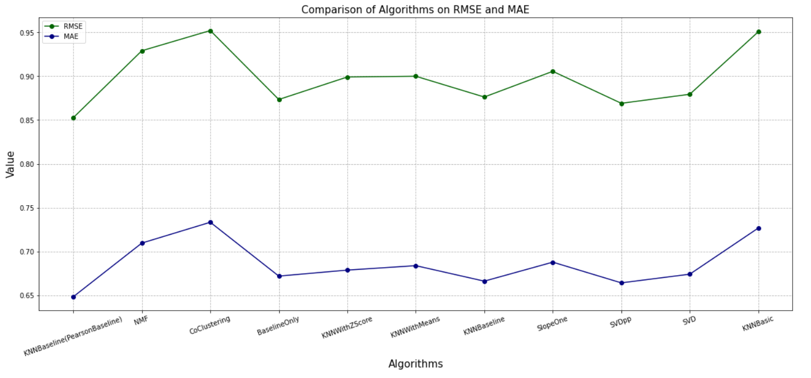
RMSE vs MAE for different algorithms

Slide 26
Conclusion:
Content based with genre is good when a user has less ratings.
Movie-Movie similarity metric using TF-IDF and Matrix Factorization Algorithm perform better compared to others
Item-item collaborative filtering works better than user-user collaborative filtering.
KNN based and SVD algorithms improve when global baselines are added.

Slide 27
Enhancements we have achieved:
Transparency and Explainability of Recommender Systems We Segregated movies into genres to give the user a better understanding of their recommendations.
﻿﻿Fairness and Unbiases of Recommender Systems We are not recommending the most popular movies only, instead we are recommending the movie based on user’s preferences or item similarity.
﻿﻿Controllability of Recommender Systems﻿:
We have performed Hyperparameter tuning while building the model
﻿

Slide 28
References:
Herwijnen, O. V. (2019). Collaborative filtering for movie recommendations using the MovieLens dataset. Retrieved from https://arxiv.org/abs/1908.09353
Shahzad, F., Javaid, A., & Haider, M. A. (2020). A hybrid movie recommendation system using collaborative filtering and content-based filtering techniques. International Journal of Advanced Computer Science and Applications, 11(3), 109-116. doi: 10.14569/IJACSA.2020.0110313
Gomathi, R., & Vaidyanathan, S. (2020). A comparative analysis of movie recommendation systems using the MovieLens dataset. International Journal of Scientific Research in Computer Science, Engineering and Information Technology, 6(4), 289-295. doi: 10.32628/CSEIT206437
Deng, C., Liu, C., & Li, J. (2021). A hybrid approach for movie recommendation using matrix factorization and deep neural networks. In Proceedings of the International Conference on Computing, Networking and Communications (pp. 670-674). IEEE. doi: 10.1109/ICCNC49042.2021.9374927

Slide 29
Thank you

